Slide 1
Targeting Success with T-Shaped Skills
A Simple Method for Building a Professional Development and Execution Plan
November 11, 2025

Slide 2
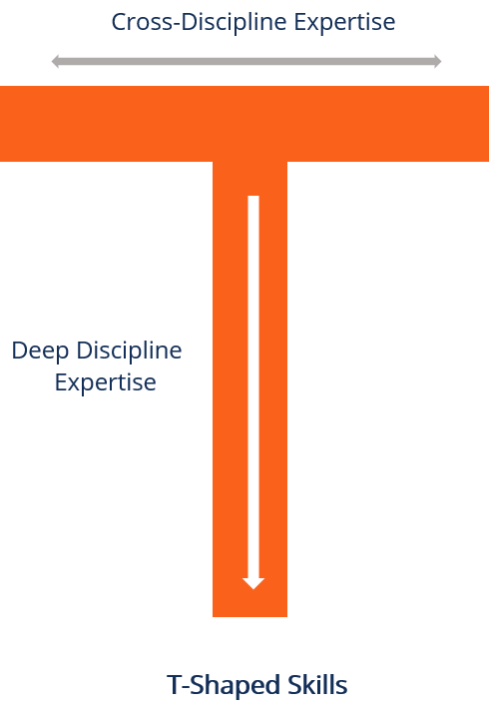
Deep and Wide
Wide: MITRE employees need a breadth of skills and experience to allow for flexibility in supporting projects in multiple domains with diverse resource needs
Deep: MITRE employees need depth of skill in a single area that will allow them to provide expert knowledge and thought leadership

Slide 3
What Are Your Skill Categories/Skill Levels/Value to Sponsor
Scale of 1-5
Scale of 1-20
Scale of 1-5
Sum
Skill * Value
Education/ Certification | Project Experience | Awards/ Feedback | Your Skill Rating | Value to Sponsor | Skill-Value Gap | Your Skill Categories | Total Score | Ranking
4 | 1 | 0 | 5 | 21 | 16 | Data Science – ML/AI | 105 | 1
4 | 10 | 2 | 16 | 3 | 0 | Agile/PM/Business | 48 | 4
1 | 2 | 1 | 4 | 2 | 0 | IT Architecture | 8 | 7
2 | 2 | 2 | 6 | 5 | 0 | Site Reliability Eng. | 30 | 5
4 | 3 | 2 | 9 | 8 | 0 | DevSecFinOps | 72 | 3
2 | 2 | 3 | 7 | 13 | 6 | Cloud Technology | 91 | 2
3 | 3 | 2 | 8 | 1 | 0 | Lean Six Sigma/VSM | 8 | 6
6. IT Architecture
5. SRE
2. Cloud Technology
1. Data Science
3. FinOps
4. Agile/PM/ Business
7. Lean Six Sigma/VSM
6
16

Slide 4
Core T
6. IT Architecture
5. SRE
2. Cloud Technology
1. Data Science
3. FinOps
4. Agile/PM/ Business
7. Lean Six Sigma/VSM
6
16
1.1 AI – Engineering
Action Plan:
Get Cloud DevOps Cert (AWS)
Get Cloud Arch. Pro. Cert (AWS)
Get Cloud Security Cert (AWS)
Get Azure Foundations Cert
Get GCP Foundations Cert
Get OCI Foundations Cert
Learn Terraform
Action Plan:
Complete Data Science Degree
Get Cloud ML Cert (AWS)
Get Data Science Project Exp.
1.2 AI – ML/Ops
1.3 Python/ PyTorch

Slide 5
Basic N Shape Skills
6. IT Architecture
5. SRE
2. Cloud Technology
1. Data Science
3. FinOps
4. Agile/PM/ Business
7. Lean Six Sigma/VSM
6
16
1.1 Cloud AI Services
1.1 AI – Engineering
1.2 Cloud DevSecOps
1.2 AI – ML/Ops
1.3 Cloud ML Services
1.3 Python/ PyTorch

Slide 6
Basic M Shape Skills
6. IT Architecture
5. SRE
2. Cloud Technology
1. Data Science
3. FinOps
4. Agile/PM/ Business
7. Lean Six Sigma/VSM
6
16
1.1 Cloud AI Services
1.1 AI – Engineering
1.1 AI for FinOps
1.2 Cloud DevSecOps
1.2 AI – ML/Ops
1.2 FinOps for Cloud AI
1.3 Cloud ML Services
1.3 Python/ PyTorch
1.3 FinOps and TBM

Slide 7
Full Skill Matrix with Core T
6. IT Architecture
5. SRE
2. Cloud Technology
1. Data Science
3. FinOps
4. Agile/PM/ Business
7. Lean Six Sigma/VSM
6
16
6.1 Infrastructure Arch.
5.1 Incident Mgmt.
1.1 Cloud AI Services
1.1 AI – Engineering
1.1 AI for FinOps
4.1 Scrum Master/PMP
7.1 Master Blackbelt
6.2 Enterprise Arch.
5.2 Monitoring
1.2 Cloud DevSecOps
1.2 AI – ML/Ops
1.2 FinOps for Cloud AI
4.2 SAFe
7.2 VSM Facilitator
6.3 Cloud Architecture
5.3 Infra. As Code
1.3 Cloud ML Services
1.3 Python/ PyTorch
1.3 FinOps and TBM
4.3 Scrum Trainer
7.3 Lean Leader

Slide 8



App Outputs for Discussion with GL/PL/Dept.
MITRE Internal Ed
External Ed
xAcademy
Percipio
Skill Soft
Degree Programs
Udemy/Udacity/etc.
Universities
Big Tech
AI-generated classes
Notebook LM?
AI-generated skill plan

Slide 9


